Slide 1

Building and Consuming FoxPro REST API Services
Rick Strahl
West Wind Technologies
www.west-wind.com
www.west-wind.com/weblog
Session materials:
https://github.com/RickStrahl/VirtualFoxFest2021-FoxProRest

Slide 2








Rick Strahl
Big Kahuna & Janitor West Wind Technologies
Author and Speaker
Popular Blog: weblog.west-wind.com
ASP.NET Insider and MVP
Tools and Components
@RickStrahl
rstrahl@west-wind.com
weblog.west-wind.com

Slide 3

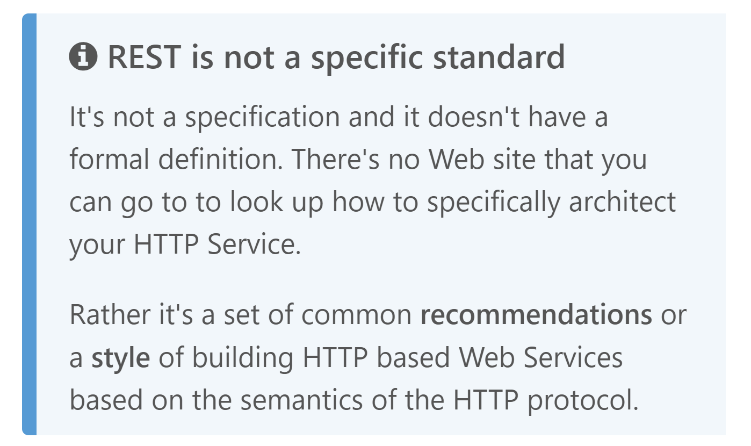
REST
Representational State Transfer
2000

Slide 4
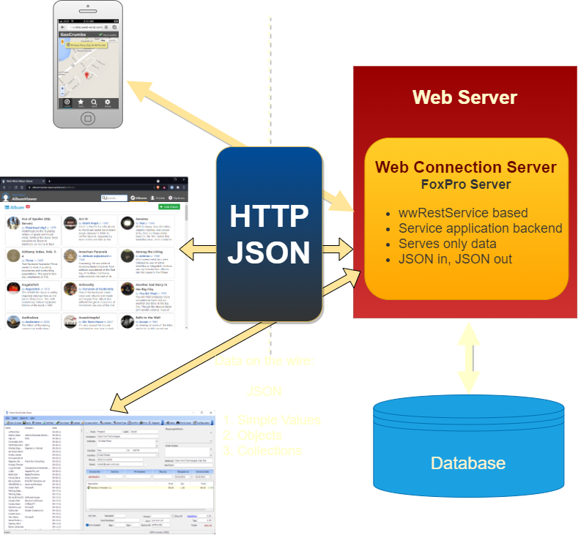
Web API Services for the REST of Us
Representational State Transfer
Huh?
Representational: Uniform resource access (URL + Verb)
State: Data sent between client and server, typically JSON
Transfer: The HTTP Protocol that carries the data
In Simple Terms
A mechanism to host Web API Services
Universal access via HTTP from anywhere
Loosely coupled front ends and back ends
Not a Standard but a Recommendation
Loose set of recommendations
Open to interpretation
Simple compared to complex architectures like SOAP
Built around HTTP and JSON
Unique Resource Routes via URLs
Actions via HTTP Verbs (GET, POST, PUT, Delete etc.)
Headers: Separation of Meta Data and Content Data
Secure encryption via https://
Built-in caching support
JSON as data transport: Simpler than XML

Slide 5
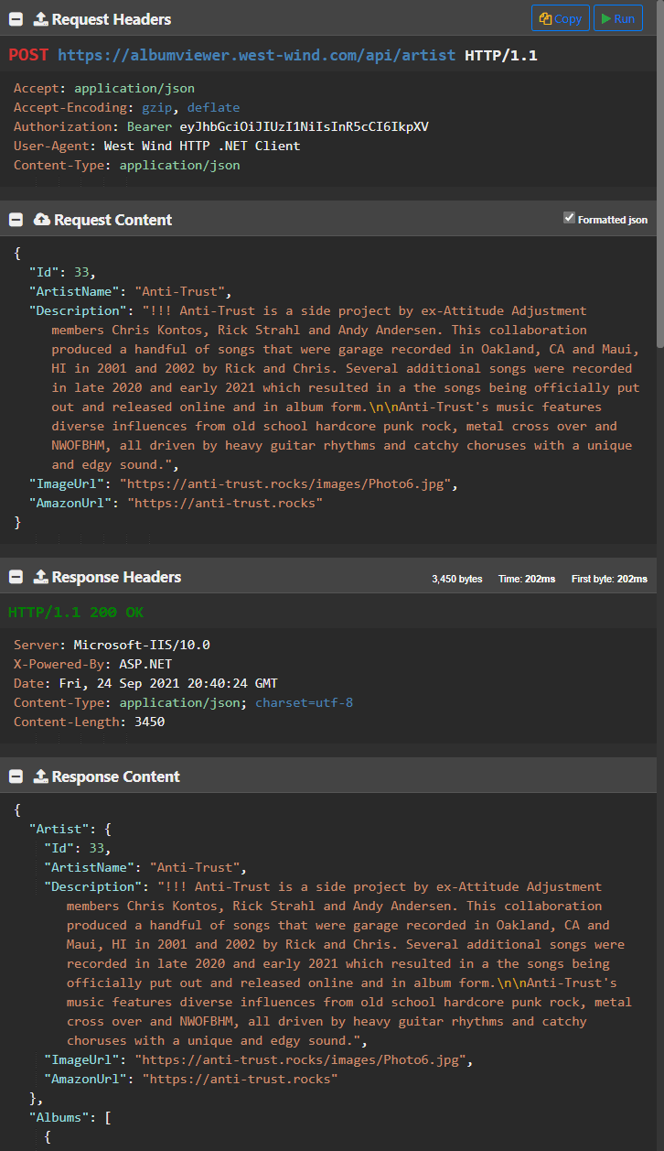
Anatomy of a REST Request
APIs over HTTP
URLs provide unique routing
Verbs provide the Action to take (GET, POST, DELETE)
HTTP Headers provide Meta Data
HTTPS provides Encryption
Request gets a Response (transactional)
Requests are always Stateless
Sending Requests
Specify URL to route, Verb for action
Every requests sends HTTP Headers
HTTP POST or PUT to send data content
Content data is serializeed as JSON
But any kind of data can be sent
Receiving Responses
Request returns Status Codes (200, 401, 401, 500 etc.)
Response Meta Data via HTTP Headers
Server returns data as JSON
But any kind of data can be returned
Status Codes return Standard Error Codes

Slide 6
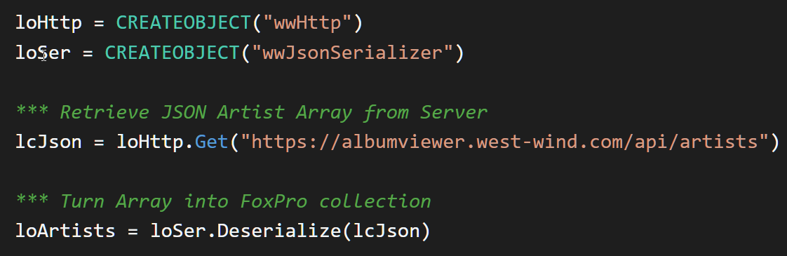
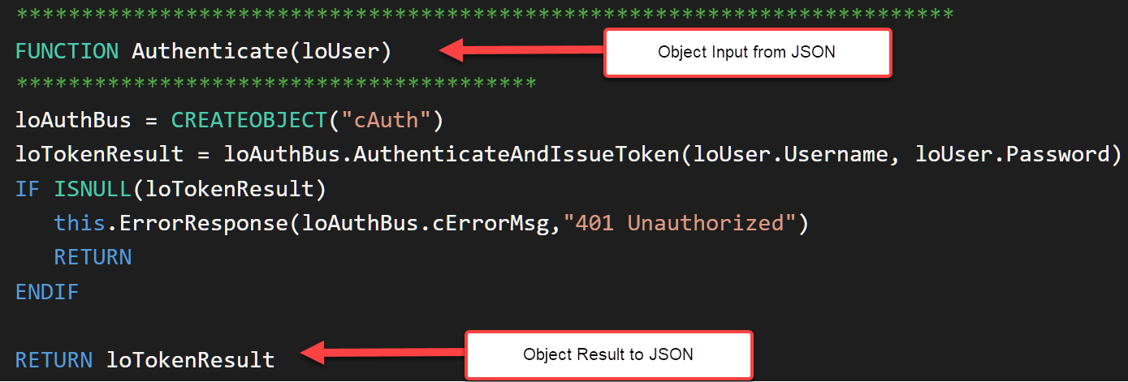
REST Application Scenarios for FoxPro
Calling REST APIs
What you need:
HTTP Client
JSON Serializer
Creating REST API Services
What you need:
Web Server
Web Application Framework
REST Framework
or: Manual JSON Serialization

Slide 7
Calling REST APIs with Visual FoxPro
Making HTTP calls
and serializing and parsing JSON

Slide 8
Calling a REST Service: Tools you need
HTTP Client
You need to make HTTP requests to send and retrieve data
Tools
WinHttp, WinInet, XMLServerHttp (native)
wwHttp (in any West Wind Tools)
Chilkat HTTP client (commercial)
JSON Serializer
Serialize FoxPro values, objects and cursors to JSON
Deserialize JSON to FoxPro values and objects
Tools
wwJsonSerializer (in any West Wind Tools)
nfJson (Github)

Slide 9
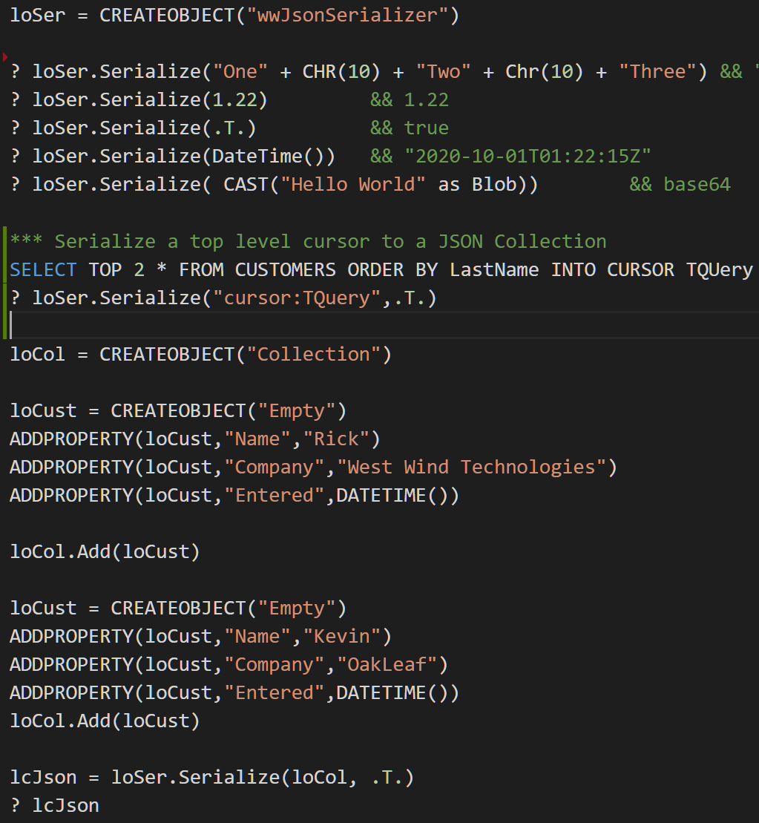
JSON Serialization
JSON
Easy to create
Easy to map to objects
JSON Types
Simple Types: JavaScript types
String, Number, Boolean, DateTime, Object, Array
FoxPro
Using wwJsonSerializer:
Serialize values, objects, collections and cursors
Parse values, objects, array

Slide 10
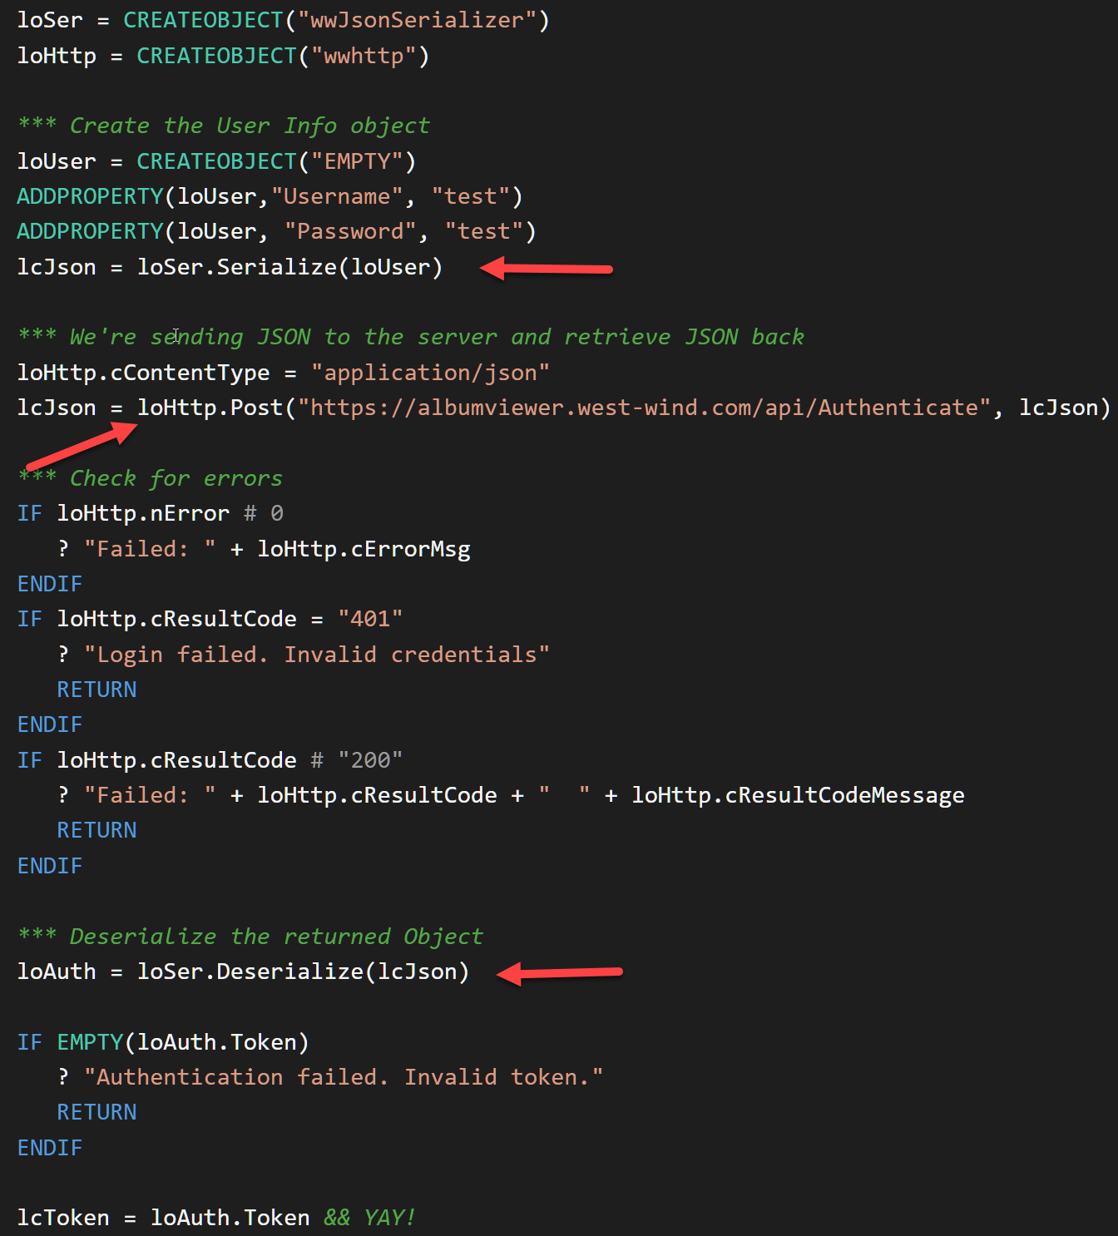
Manually calling a REST Service
Set up your data
FoxPro values
FoxPro objects, collections
Cursors or Tables
Serialize data to JSON
Call the server over HTTP
Capture JSON response
Deserialize JSON
To FoxPro value
To FoxPro object, collection
To Cursor: No direct support

Slide 11
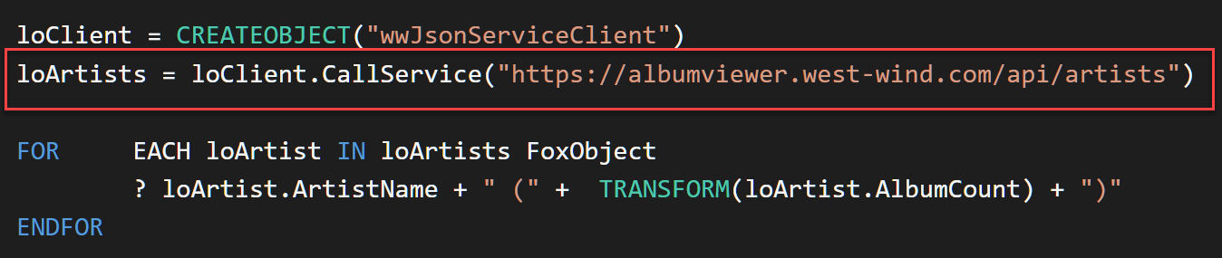
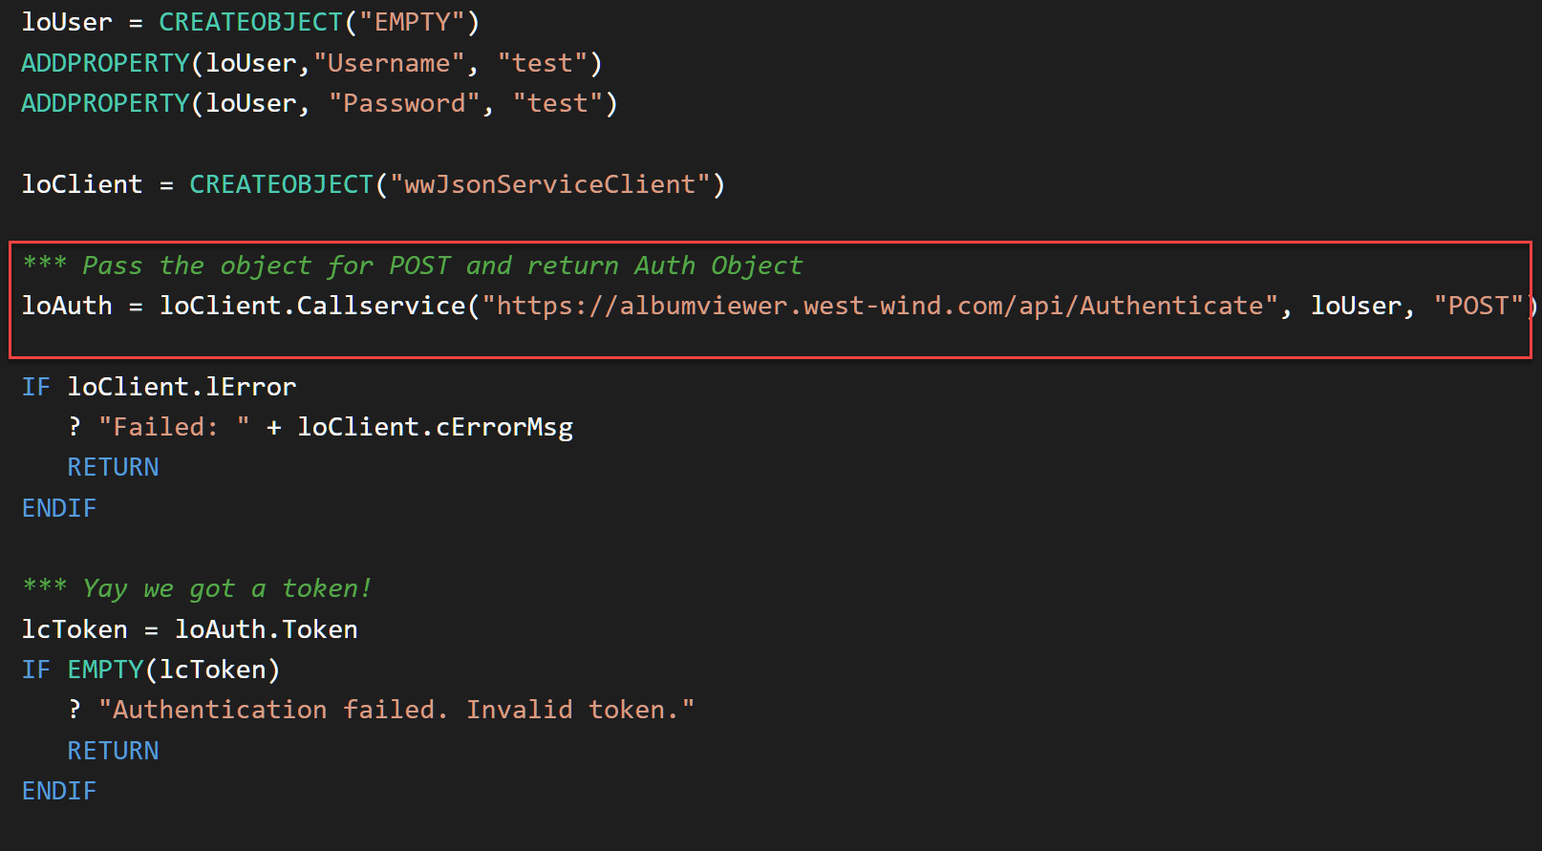
Simplify with a Service Wrapper
Manual Code is repetitive
Abstract call into wrapper class
Simplify service calls
Provide a base class to inherit
wwJsonService
REST calls as single method call
Handles errors
Overrides for HTTP and Serializer
Simplified REST Calls
JSON Serialization of input
HTTP Service Call
JSON Deserialization of result
Consistent Error Handling

Slide 12
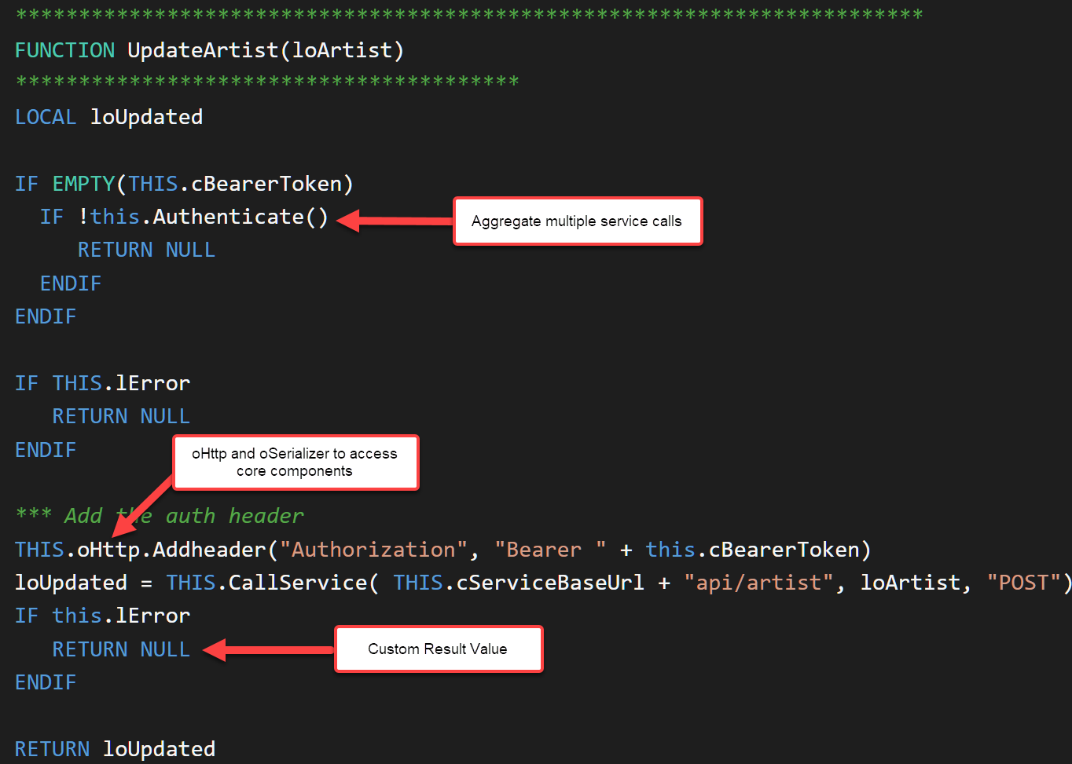
Build your own Service Classes
Uses wwJsonServiceClient
Subclass wwJsonService client
Add custom service methods
Centralize Service Access Code
Aggregation
Allows pre/post processing
Allows for consistent error handling
Allows to combine services
Consistency
Single place for all Service logic
Error handling can be centralized
Internalize HTTP and JSON logic
Custom return values
Application only sees a ‘business’ object

Slide 13
Creating a FoxPro REST Service with Web Connection
Serving a JSON REST API
From Visual Foxpro

Slide 14
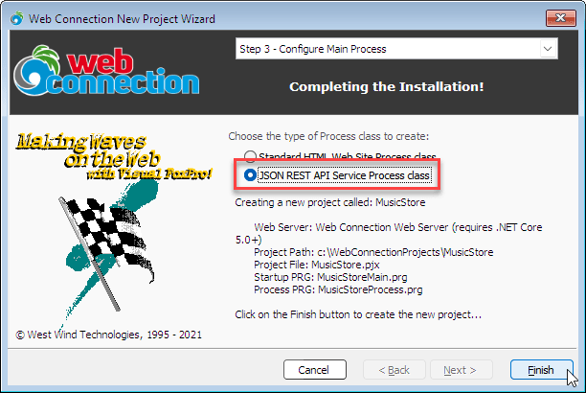
Creating a REST Service with Web Connection
New REST Service Class
Special wwRestProcess wwProcess subclass
Use FoxPro class methods as RPC endpoints
Receives single JSON object/value as Parameter
Return a FoxPro value, object or cursor into JSON
Create with Web Connection Project Wizard
Create a new Project or New Process
Choose Create REST Service
Creates a new REST Process class
Add methods for each endpoint
Accept single parameter
Do your processing
Return an object or value or cursor
Example URL: http://localhost:5200/Artists.ms

Slide 15
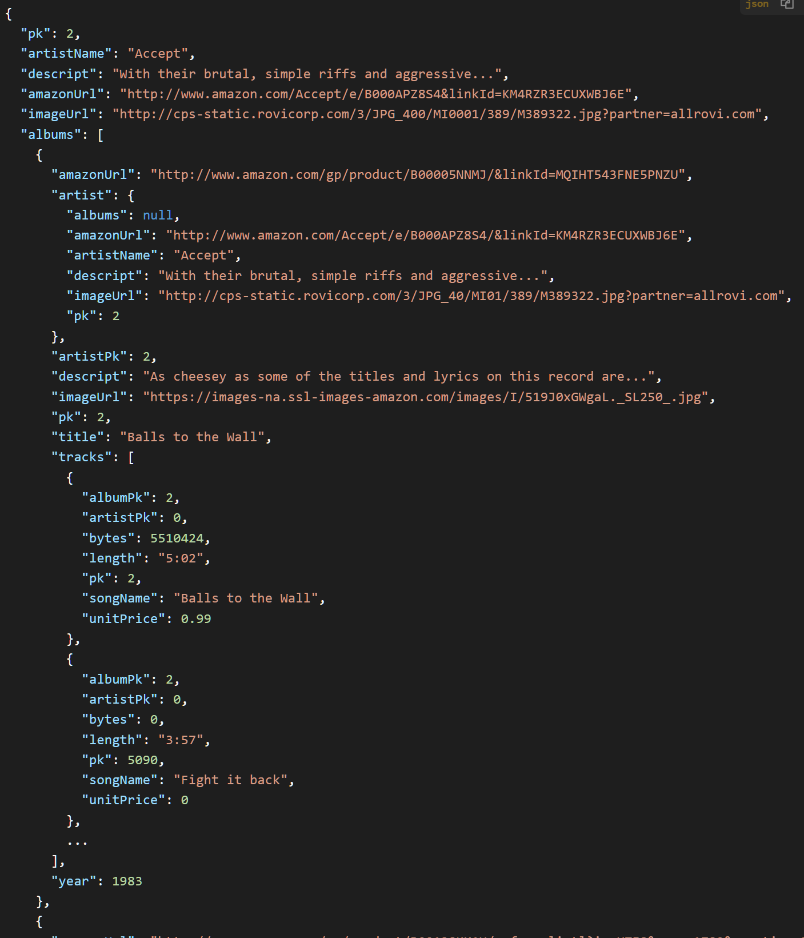
Object Composition
How to return data
Flat objects
Collections of Objects
Cursors (returned as arrays)
Think hierarchal, not relational
You can create more complex structures
Nested objects
Nested collections
Nested cursors
Multilevel objects
FoxPro Structures
loAuth = CREATEOBJECT("EMPTY")
ADDPROPERTY(loAuth, "Token", lcToken)
You can add collections
You can add cursor props: "cursor:Tracks"

Slide 16
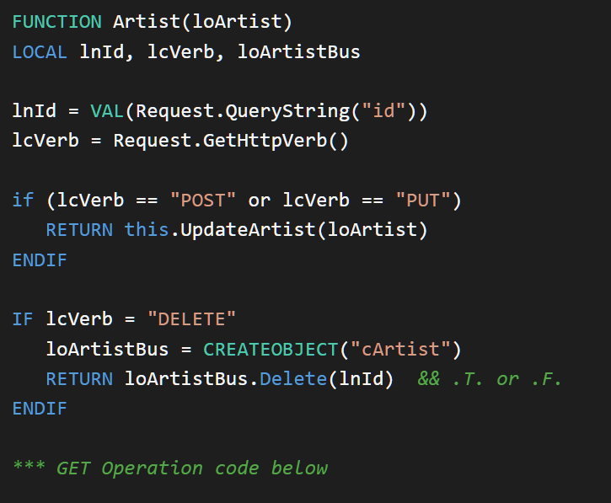
Overloading on HTTP Verbs
Unique Resources
URLs identify a resource
HTTP Verb determines operation
URL + HTTP Verb == Unique Resource
Same URL, Different Verb
You can ‘overload’ the Verb
GET: Retrieve item
POST: Add Item
PUT: Update Item
DELETE: Delete Item
All using the Same URL
Route By Name and Verb
Hit same Process Method
Check HTTP Verb
If not default call alternate method

Slide 17
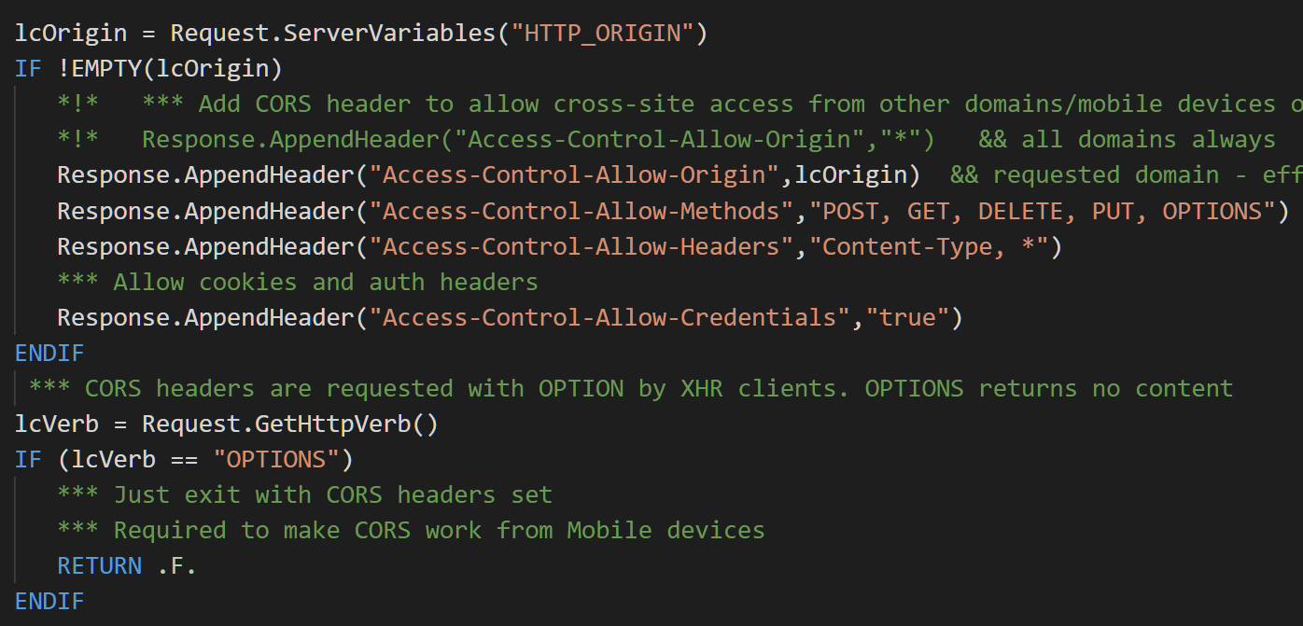
CORS: Required for Web Browsers
Browsers require CORS
XHR or Fetch Requests
Typically for SPA apps
Check each requests to ensure access by Origin is allowed
Server Code
Handle on every request
In OnProcessInit()
Add to any non-local request
Handle OPTIONS Verb

Slide 18
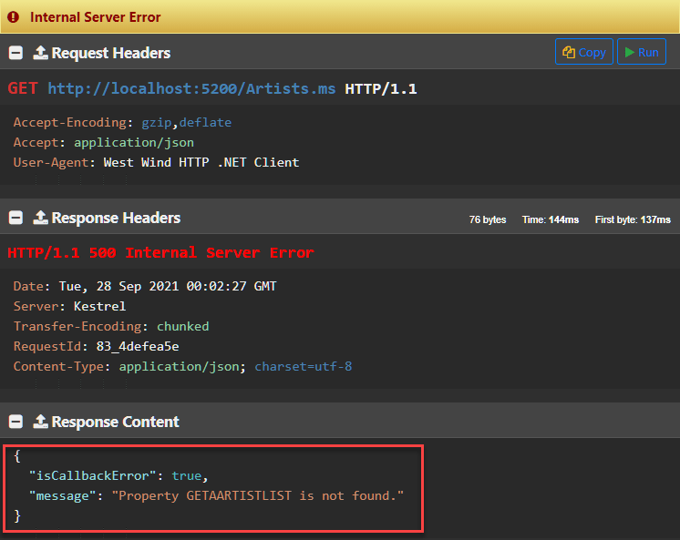
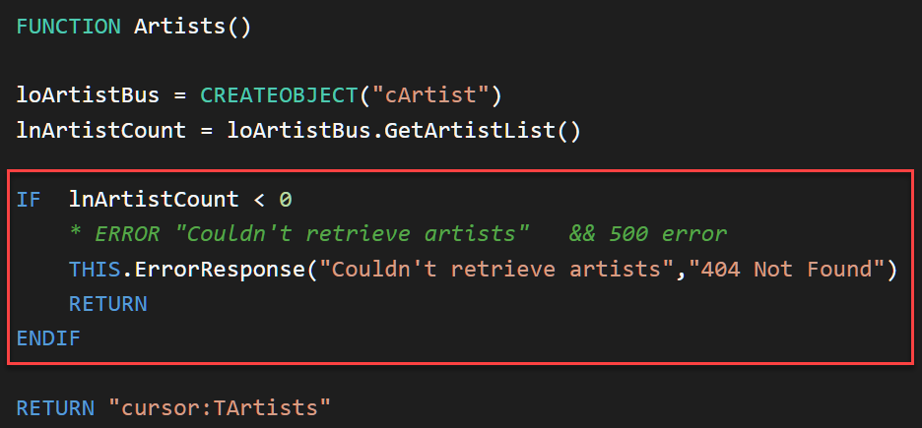
Error Handling
Error Handling is Critical
First line: HTTP Status Codes
Error Messages via content
Status Codes
500 for hard errors
401 for Unauthorized Access
404 for Not Found
Don’t return 200 OK for Errors!
Try to return JSON for Errors
If possible catch your own errors
RETURN this.ErrorResponse()
Web Connection catches errors and creates status 500 + JSON responses

Slide 19
Summary
REST is Here to Stay
Most modern services use REST to expose functionality
It’s simplicity is its strength
Easy to interact with from Visual FoxPro
Understand HTTP
REST is all about HTTP
Get familiar with the HTTP Protocol
Keep it simple! Don’t overthink it.
FoxPro is well Suited For REST
Much more so than SOAP, REST is a good fit for FoxPro
Tools are available to ‘do’ REST
Both low level and high level tools are available

Slide 20
Thank you!
Resources
Github: Source Code, White Paper and Slides https://github.com/RickStrahl/VirtualFoxFest2021-FoxProRest
Contact Rick
@RickStrahl on Twitter
https://weblog.west-wind.com – general blog
https://west-wind.com/wconnect/weblog/ - Fox blog
https://support.west-wind.com - support message board
rstrahl@west-wind.com

